Slide 1
Operating system BIT253CO
By: Er Suvash Chandra Gautam
(System Development and Implementation Expert, NBCC-JICA)

Slide 2
Processes and Threads

Slide 3
Introduction
A process is an instance of a program that is being executed. When we run a program, it does not execute directly. It takes some time to follow all the steps required to execute the program, and following these execution steps is known as a process.
A process can create other processes to perform multiple tasks at a time; the created processes are known as clone or child process, and the main process is known as the parent process. Each process contains its own memory space and does not share it with the other processes. It is known as the active entity. A typical process remains in the below form in memory.

Slide 4
Process
Process memory is divided into four sections for efficient working :
The Text section is made up of the compiled program code, read in from non-volatile storage when the program is launched.
The Data section is made up of the global and static variables, allocated and initialized prior to executing the main.
The Heap is used for the dynamic memory allocation and is managed via calls to new, delete, malloc, free, etc.
The Stack is used for local variables. Space on the stack is reserved for local variables when they are declared.

Slide 5
Process
A process is an 'active' entity as opposed to the program which is considered to be a 'passive' entity. Attributes held by the process include hardware state, memory, CPU, etc.

Slide 6
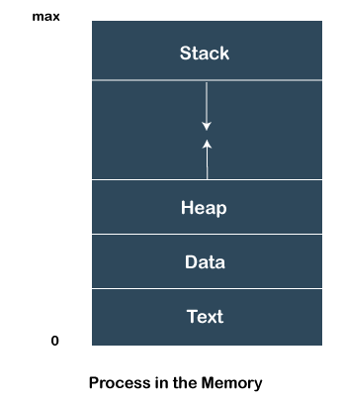
Process

Slide 7
Process State
NEW: A new process is being created.
READY: A process is ready and waiting to be allocated to a processor.
RUNNING: The program is being executed.
WAITING: Waiting for some event to happen or occur.
TERMINATED: Execution finished.

Slide 8
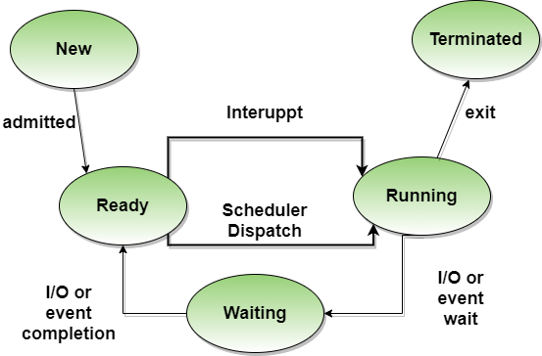

Slide 9
Features of Process
Each time we create a process, we need to make a separate system call for each process to the OS. The fork() function creates the process.
Each process exists within its own address or memory space.
Each process is independent and treated as an isolated process by the OS.
Processes need IPC (Inter-process Communication) in order to communicate with each other.
A proper synchronization between processes is not required.

Slide 10
Process Model
A process is a program under execution that consists of a number of elements including, program code and a set of data. To execute a program, a process has to be created for that program. Here the process may or may not run but if it is in a condition of running then that has to be maintained by the OS for appropriate progress of the process to be gained.

Slide 11
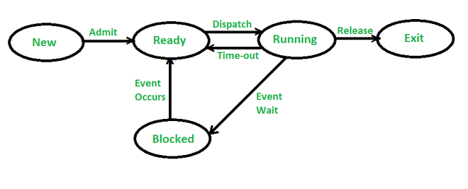

Slide 12
Process Model
Running: It means a process that is currently being executed. Assuming that there is only a single processor in the below execution process, so there will be at most one processor at a time that can be running in the state.
Ready: It means a process that is prepared to execute when given the opportunity by the OS.
Blocked/Waiting: It means that a process cannot continue executing until some event occurs like for example, the completion of an input-output operation.
New: It means a new process that has been created but has not yet been admitted by the OS for its execution. A new process is not loaded into the main memory, but its process control block (PCB) has been created.
Exit/Terminate: A process or job that has been released by the OS, either because it is completed or is aborted for some issue.

Slide 13
Possible State Transitions
Null -> New: A new process is created for the execution of a process.
New -> Ready: The system will move the process from new to ready state and now it is ready for execution. Here a system may set a limit so that multiple processes can’t occur otherwise there may be a performance issue.
Ready -> Running: The OS now selects a process for a run and the system chooses only one process in a ready state for execution.
Running -> Exit: The system terminates a process if the process indicates that is now completed or if it has been aborted.

Slide 14
Possible State Transitions
Running -> Ready: The reason for which this transition occurs is that when the running process has reached its maximum running time for uninterrupted execution. An example of this can be a process running in the background that performs some maintenance or other functions periodically.
Running -> Blocked: A process is put in the blocked state if it requests for something it is waiting. Like, a process may request some resources that might not be available at the time or it may be waiting for an I/O operation or waiting for some other process to finish before the process can continue.
Blocked -> Ready: A process moves from blocked state to the ready state when the event for which it has been waiting.
Ready -> Exit: This transition can exist only in some cases because, in some systems, a parent may terminate a child’s process at any time.

Slide 15
Process Control Block
While creating a process, the operating system performs several operations. To identify the processes, it assigns a process identification number (PID) to each process. As the operating system supports multi-programming, it needs to keep track of all the processes. For this task, the process control block (PCB) is used to track the process’s execution status. Each block of memory contains information about the process state, program counter, stack pointer, status of opened files, scheduling algorithms, etc.

Slide 16
Process Control Block
All this information is required and must be saved when the process is switched from one state to another. When the process makes a transition from one state to another, the operating system must update information in the process’s PCB. A process control block (PCB) contains information about the process, i.e. registers, quantum, priority, etc. The process table is an array of PCBs, that means logically contains a PCB for all of the current processes in the system.

Slide 17
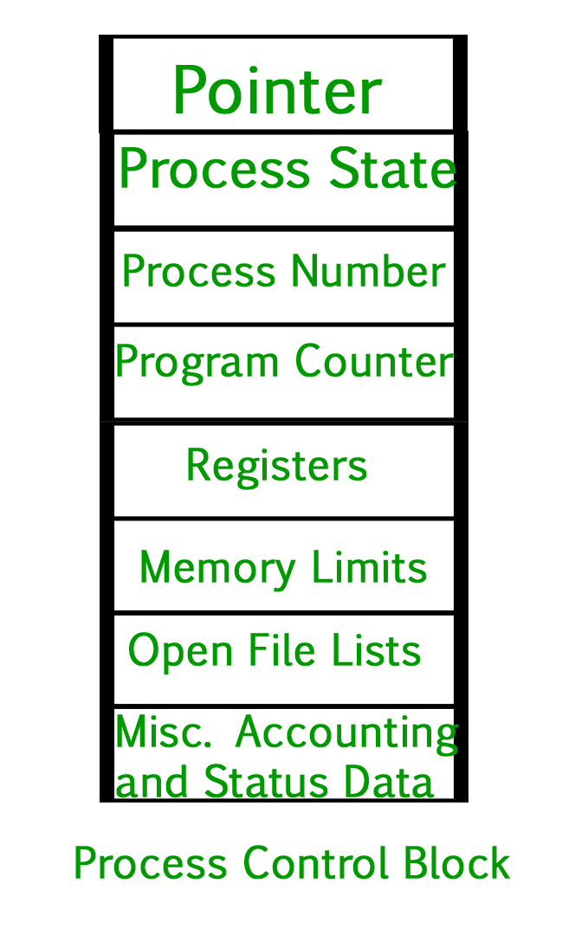

Slide 18
Process Control Block
Pointer: It is a stack pointer that is required to be saved when the process is switched from one state to another to retain the current position of the process.
Process state: It stores the respective state of the process.
Process number: Every process is assigned a unique id known as process ID or PID which stores the process identifier.
Program counter: It stores the counter,: which contains the address of the next instruction that is to be executed for the process.
Register: These are the CPU registers which include the accumulator, base, registers, and general-purpose registers.
Memory limits: This field contains the information about memory management system used by the operating system. This may include page tables, segment tables, etc.
Open files list : This information includes the list of files opened for a process.

Slide 19
Introduction to Thread
A thread is the subset of a process and is also known as the lightweight process.
A process within a process is called thread.
A process can have more than one thread, and these threads are managed independently by the scheduler. All the threads within one process are interrelated to each other. Threads have some common information, such as data segment, code segment, files, etc., that is shared to their peer threads. But contains its own registers, stack, and counter.

Slide 20
Features of Thread
Threads share data, memory, resources, files, etc., with their peer threads within a process.
One system call is capable of creating more than one thread.
Each thread has its own stack and register.
Threads can directly communicate with each other as they share the same address space.
Threads need to be synchronized in order to avoid unexpected scenarios.

Slide 21
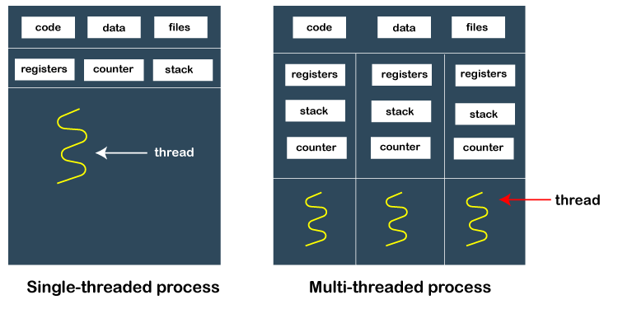

Slide 22
How does thread work?
When a process starts, OS assigns the memory and resources to it. Each thread within a process shares the memory and resources of that process only.
Threads are mainly used to improve the processing of an application. In reality, only a single thread is executed at a time, but due to fast context switching between threads gives an illusion that threads are running parallelly.
If a single thread executes in a process, it is known as a single-threaded And if multiple threads execute simultaneously, then it is known as multithreading.

Slide 23
Types of Thread
1. User Level Thread:
As the name suggests, the user-level threads are only managed by users, and the kernel does not have its information.
These are faster, easy to create and manage.
The kernel takes all these threads as a single process and handles them as one process only.
The user-level threads are implemented by user-level libraries, not by the system calls.

Slide 24
Advantages of User-level threads
The user threads can be easily implemented than the kernel thread.
User-level threads can be applied to such types of operating systems that do not support threads at the kernel-level.
It is faster and efficient.
Context switch time is shorter than the kernel-level threads.
It does not require modifications of the operating system.
User-level threads representation is very simple. The register, PC, stack, and mini thread control blocks are stored in the address space of the user-level process.
It is simple to create, switch, and synchronize threads without the intervention of the process.

Slide 26
Types of Thread
2. Kernel-Level Thread:
The kernel-level threads are handled by the Operating system and managed by its kernel. These threads are slower than user-level threads because context information is managed by the kernel. To create and implement a kernel-level thread, we need to make a system call.

Slide 27
Advantages of Kernel-level threads
The kernel-level thread is fully aware of all threads.
The scheduler may decide to spend more CPU time in the process of threads being large numerical.
The kernel-level thread is good for those applications that block the frequency.

Slide 28
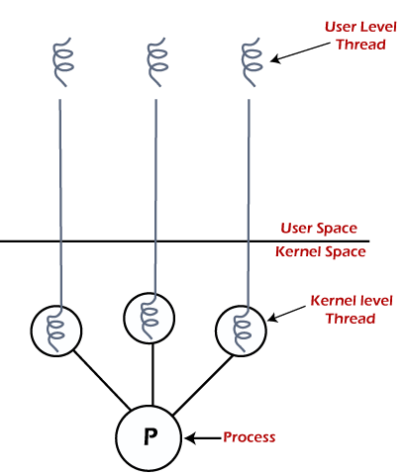

Slide 29
Feature | User Level Threads | Kernel Level Threads
Implemented by | It is implemented by the users. | It is implemented by the OS.
Context switch time | Its time is less. | Its time is more.
Multithreading | Multithread applications are unable to employ multiprocessing in user-level threads. | It may be multithreaded.
Implementation | It is easy to implement. | It is complicated to implement.
Blocking Operation | If a thread in the kernel is blocked, it blocks all other threads in the same process. | If a thread in the kernel is blocked, it does not block all other threads in the same process.
Recognize | OS doesn't recognize it. | It is recognized by OS.
Thread Management | Its library includes the source code for thread creation, data transfer, thread destruction, message passing, and thread scheduling. | The application code on kernel-level threads does not include thread management code, and it is simply an API to the kernel mode.
Hardware Support | It doesn't need hardware support. | It requires hardware support.
Creation and Management | It may be created and managed much faster. | It takes much time to create and handle.
Examples | Some instances of user-level threads are Java threads and POSIX threads. | Some instances of Kernel-level threads are Windows and Solaris.
Operating System | Any OS may support it. | The specific OS may support it.

Slide 30
Components of Threads
Program counter
Register set
Stack space

Slide 31
Benefits of Threads
Enhanced throughput of the system: When the process is split into many threads, and each thread is treated as a job, the number of jobs done in the unit time increases. That is why the throughput of the system also increases.
Effective Utilization of Multiprocessor system: When you have more than one thread in one process, you can schedule more than one thread in more than one processor.
Faster context switch: The context switching period between threads is less than the process context switching. The process context switch means more overhead for the CPU.
Responsiveness: When the process is split into several threads, and when a thread completes its execution, that process can be responded to as soon as possible.

Slide 32
Benefits of Threads
Communication: Multiple-thread communication is simple because the threads share the same address space, while in process, we adopt just a few exclusive communication strategies for communication between two processes.
Resource sharing: Resources can be shared between all threads within a process, such as code, data, and files. Note: The stack and register cannot be shared between threads. There is a stack and register for each thread.

Slide 33
Process vs Program
Process | Program
The process is basically an instance of the computer program that is being executed. | A Program is basically a collection of instructions that mainly performs a specific task when executed by the computer.
A process has a shorter lifetime. | A Program has a longer lifetime.
A Process requires resources such as memory, CPU, Input-Output devices. | A Program is stored by hard-disk and does not require any resources.
A process has a dynamic instance of code and data | A Program has static code and static data.
Basically, a process is the running instance of the code. | On the other hand, the program is the executable code.

Slide 34
Process Scheduling
When there are two or more runnable processes then it is decided by the Operating system which one to run first then it is referred to as Process Scheduling.
A scheduler is used to make decisions by using some scheduling algorithm.
Given below are the properties of a Good Scheduling Algorithm:

Slide 35
Response time should be minimum for the users.
The number of jobs processed per hour should be maximum i.e. Good scheduling algorithm should give maximum throughput.
The utilization of the CPU should be 100%.
Each process should get a fair share of the CPU.

Slide 36
